Slide 1
Service Mesh
Kubernetes on AWS
version 0.8.2

Slide 2
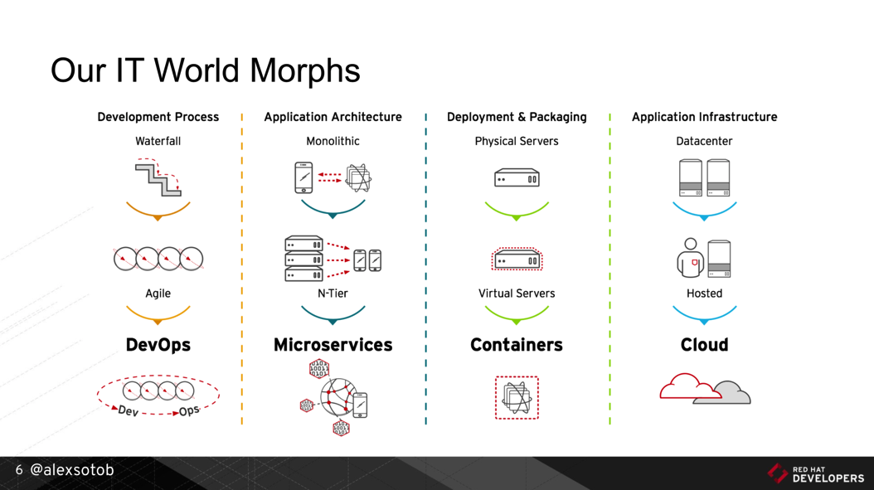
1. Digital Transformation: IT World is changing
https://www.slideshare.net/asotobu/sail-in-the-cloud

Slide 3
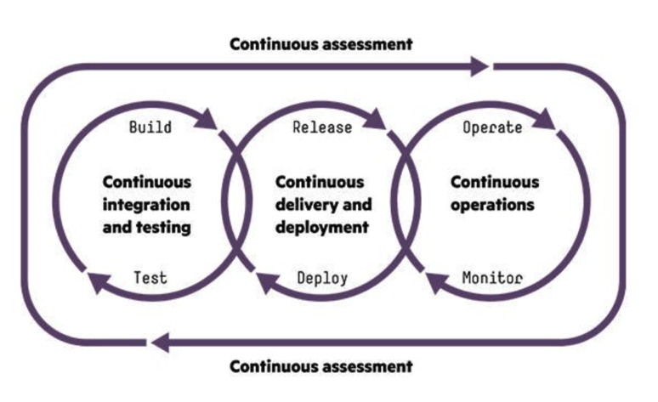
1. Digital Transformation: CI/CD, DevOps, Jenkins,..
https://www.slideshare.net/asotobu/sail-in-the-cloud

Slide 4
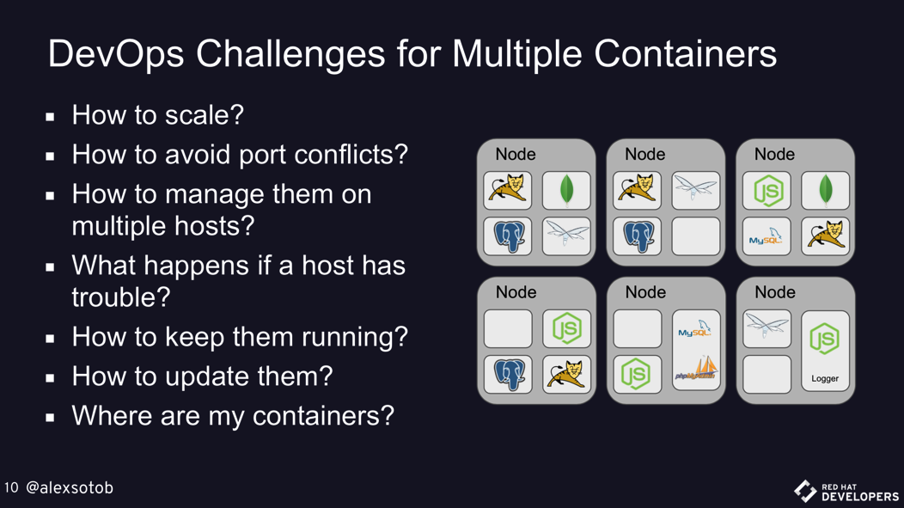
1. Digital Transformation: New challenges
https://www.slideshare.net/asotobu/sail-in-the-cloud

Slide 5
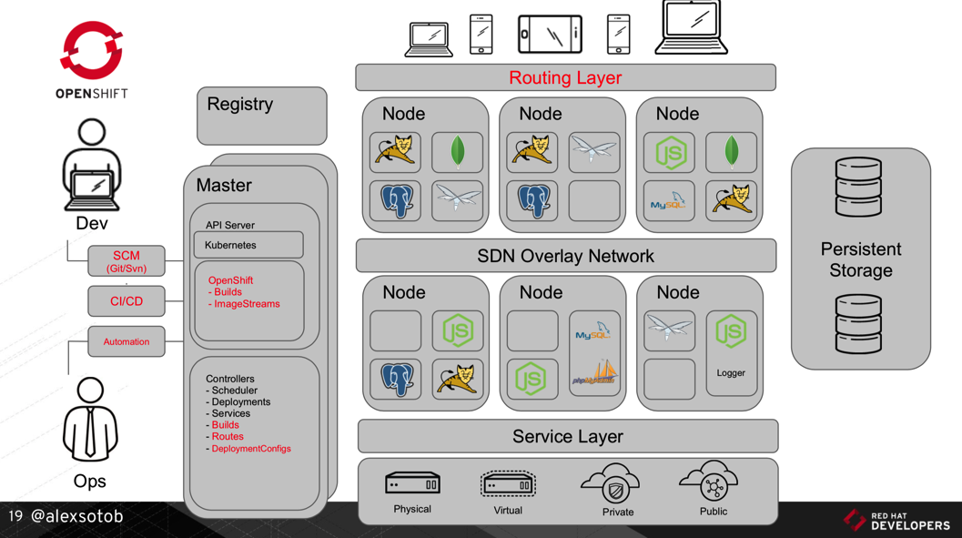
1. Digital Transformation: A new Platform
https://www.slideshare.net/asotobu/sail-in-the-cloud

Slide 6
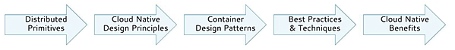
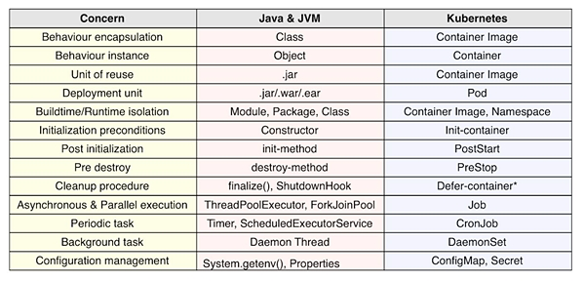
2. Kubernetes effect on the SDLC: Primitives (1/2)
1
https://www.infoq.com/articles/kubernetes-effect

Slide 7
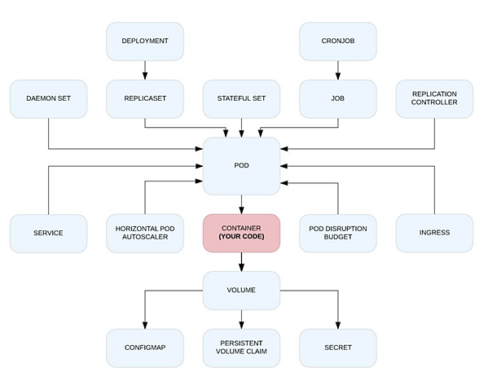
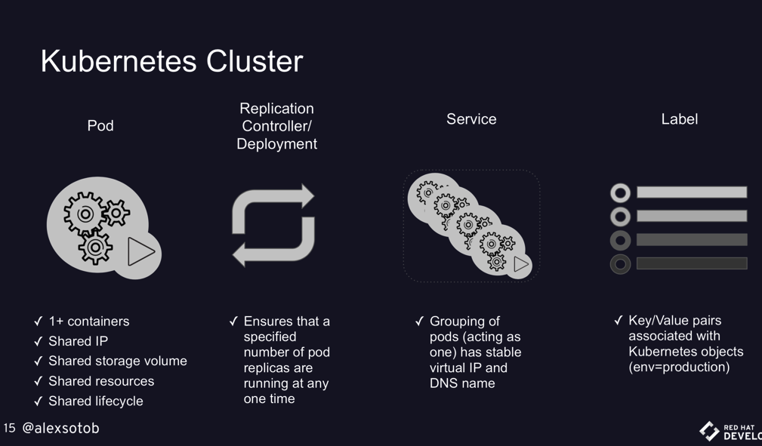
2. Kubernetes effect on the SDLC: Primitives (2/2)
1
https://www.infoq.com/articles/kubernetes-effect
https://www.slideshare.net/asotobu/sail-in-the-cloud

Slide 8
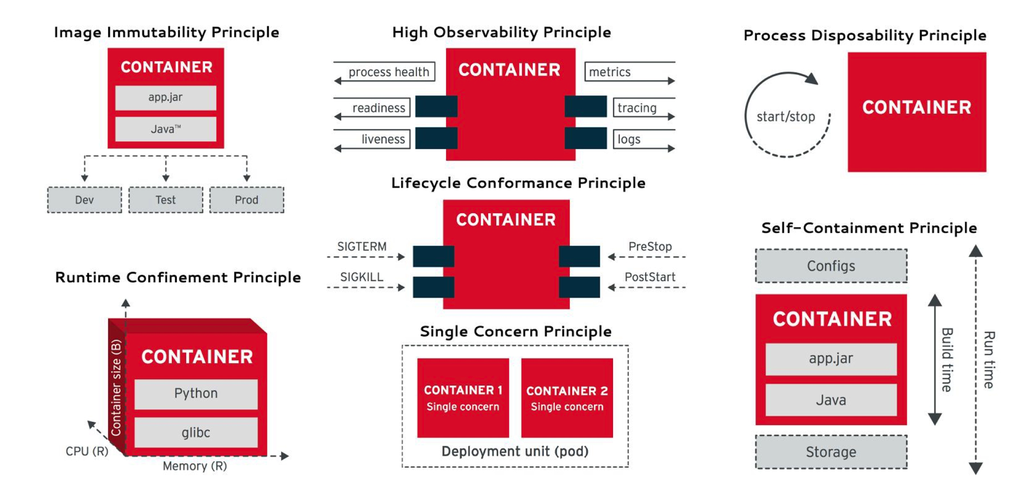
2. Kubernetes effect on the SDLC: Principles
2
https://www.infoq.com/articles/kubernetes-effect

Slide 9
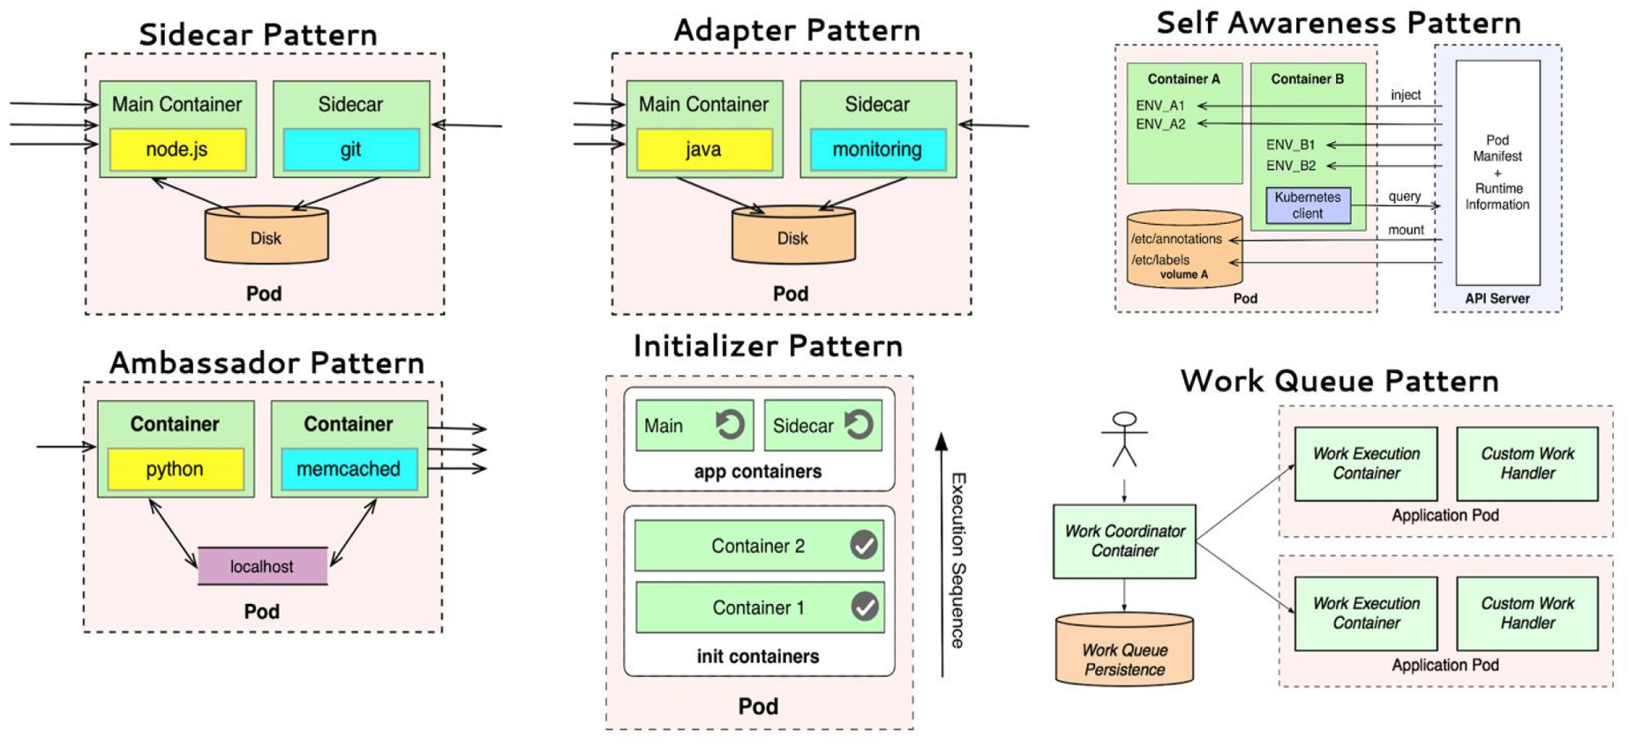
2. Kubernetes effect on the SDLC: Patterns
3
https://www.infoq.com/articles/kubernetes-effect

Slide 10
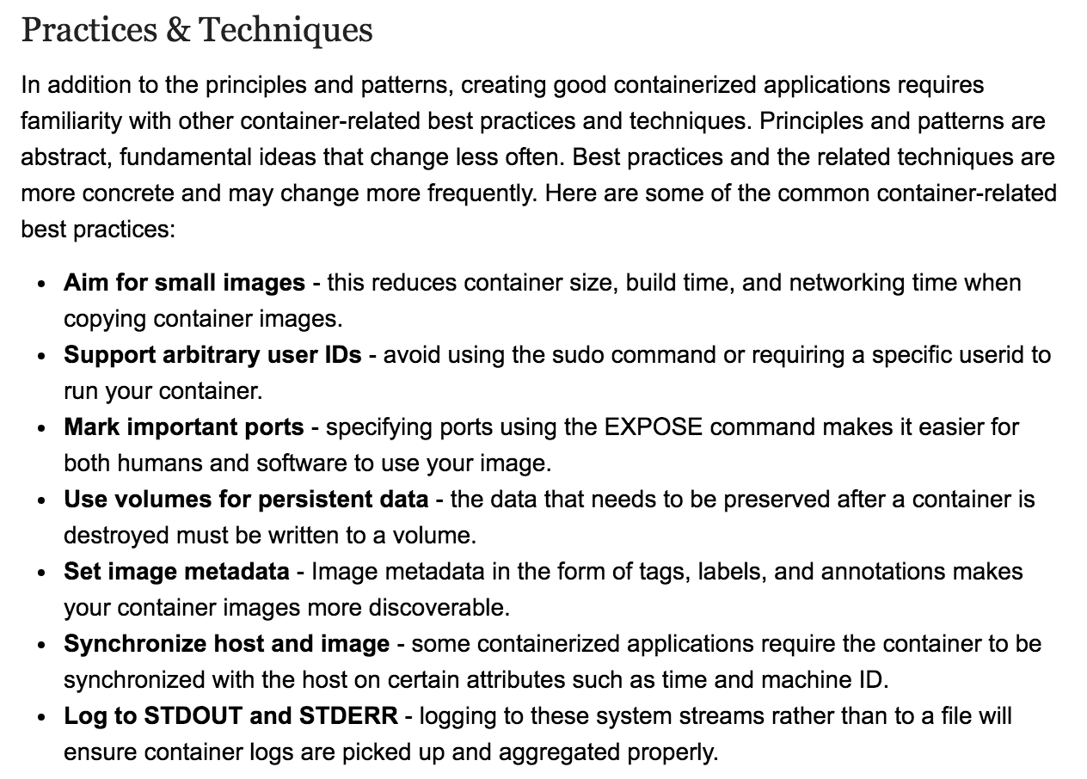
2. Kubernetes effect on the SDLC: Best Practices
4
https://www.infoq.com/articles/kubernetes-effect

Slide 11
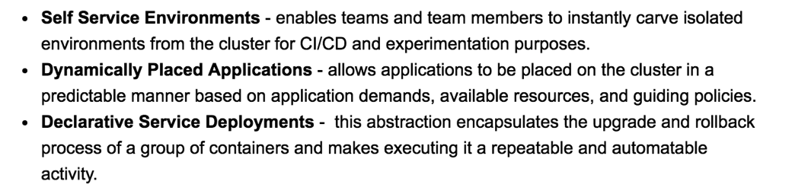
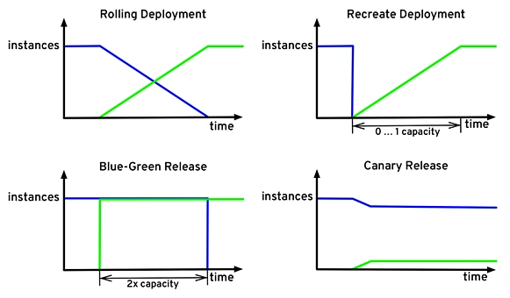
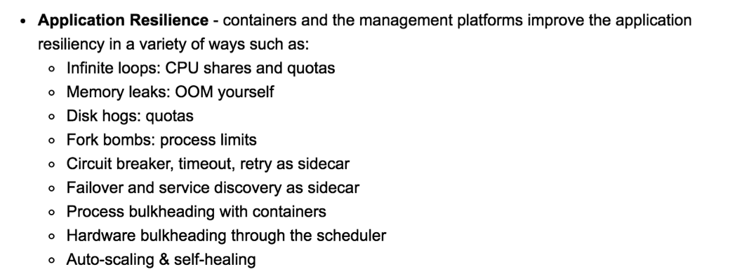
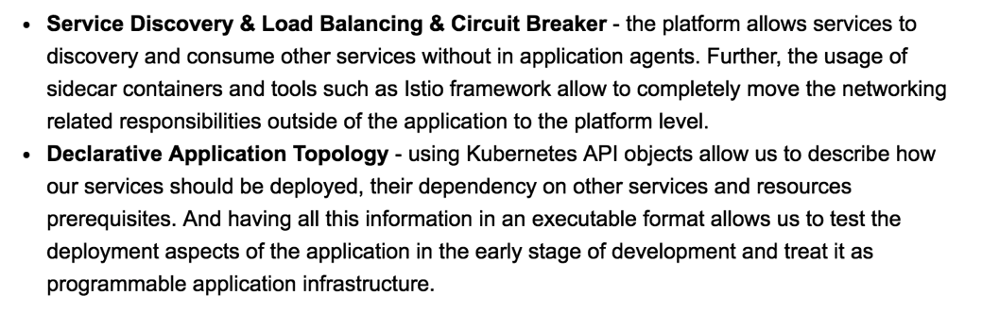
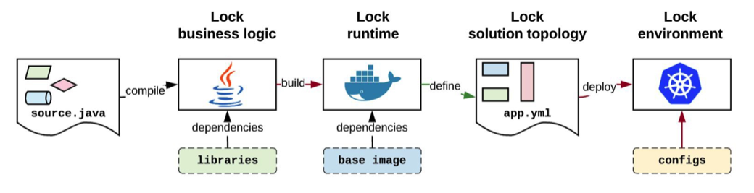
2. Kubernetes effect on the SDLC: Benefits
5
https://www.infoq.com/articles/kubernetes-effect

Slide 12

3. Lab 00: Building K8s - choose yours (1/2)
Vanilla
Kubernetes Clients
Kubernetes flavours
Self Managed
Full Managed Cloud
kubectl
(kubernetes)
Kubernetes Cluster
On-premise
Google Kubernetes Engine
KVM
VMWare
oc (openshift)
RedHat OpenShift v3
Azure Container Service (AKS)
Amazon EC2
az
(azure)
RedHat OpenShift Container Platform
Minimalist
Minikube
OpenShift
Minishift
Amazon Fargate
Amazon EKS
Amazon ECS
Managed

Slide 13
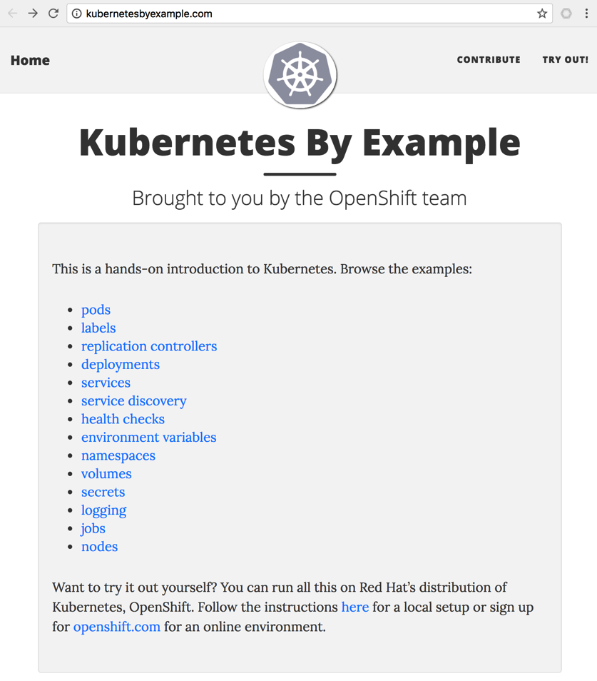
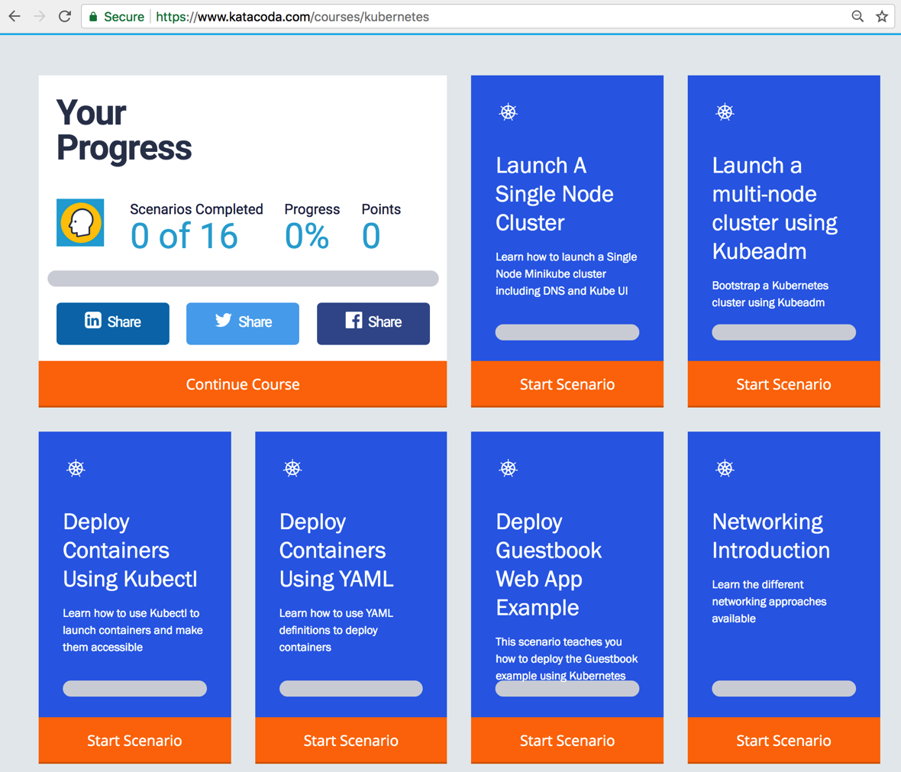
3. Lab 00: Building K8s - acquire practice (2/2)
1
http://kubernetesbyexample.com
https://www.katacoda.com/courses/kubernetes

Slide 14

3. Lab 01: Delivering Services on Kubernetes
Hosting (Amazon EC2)
Kubernetes
Node₁
Edge Proxy
(Load Balancer)
Port₁
LoadBalancer
http://PublicIP₁:Port_{pub1}
nodePort₁
Pod₁
Docker₁
Docker Registry
Port₂: 5002
NodePort
nodePort₂
(hello-svc-np)
5000
(hello-v1)
Node₂
Port₃
ClusterIP
Pod₂
nodePort₃: --
Docker₂
5000
(hello-v2)
curl <clusterIP>:<nodePort>/hello
Services
Deployment
## scheduling step by step
$ kubectl apply –f labs/kube/01-delivering-on-k8s/hello-ns-sa.yaml
$ kubectl apply –f labs/kube/01-delivering-on-k8s/hello-deployment.yaml
$ kubectl apply –f labs/kube/01-delivering-on-k8s/hello-services.yaml
## scheduling all together
$ kubectl apply –f labs/kube/01-delivering-on-k8s/hello-all.yaml

Slide 15

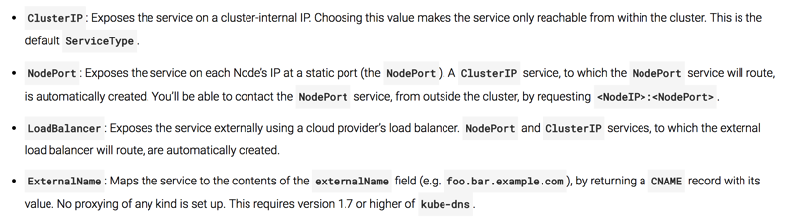
3. Lab 02: Exposing Services – Ingress
Hosting (Amazon EC2)
Edge Proxy
(Load Balancer)
Kubernetes
Node₁
Port₁: 81, CIP₁
Services
LoadBalancer
http://PublicIP₁:Port_{pub1}
Pod₁
Ingress Controller
nodePort₁
Docker₁
http://PublicIP₂:Port_{pub2}
Port₂: 82, CIP₂
NodePort
nodePort₂
8080
Route <http>://<IP>:<Port>/<Path>
To CIP₂:Port₂
Port₃: 83, CIP₃
ClusterIP
nodePort₃: --
Kubernetes
Node₂
Pod₂
Docker₂
8080
External Network
spec.loadBalancerIp:spec.pops[*].port
Internal Network (Backend)
<NodeIP>:spec.ports[*].nodePort
spec.clusterIp:spec.ports[*].port

Slide 16
3. Lab 03: Weaving Service Mesh – Ref. Arch.

Slide 17
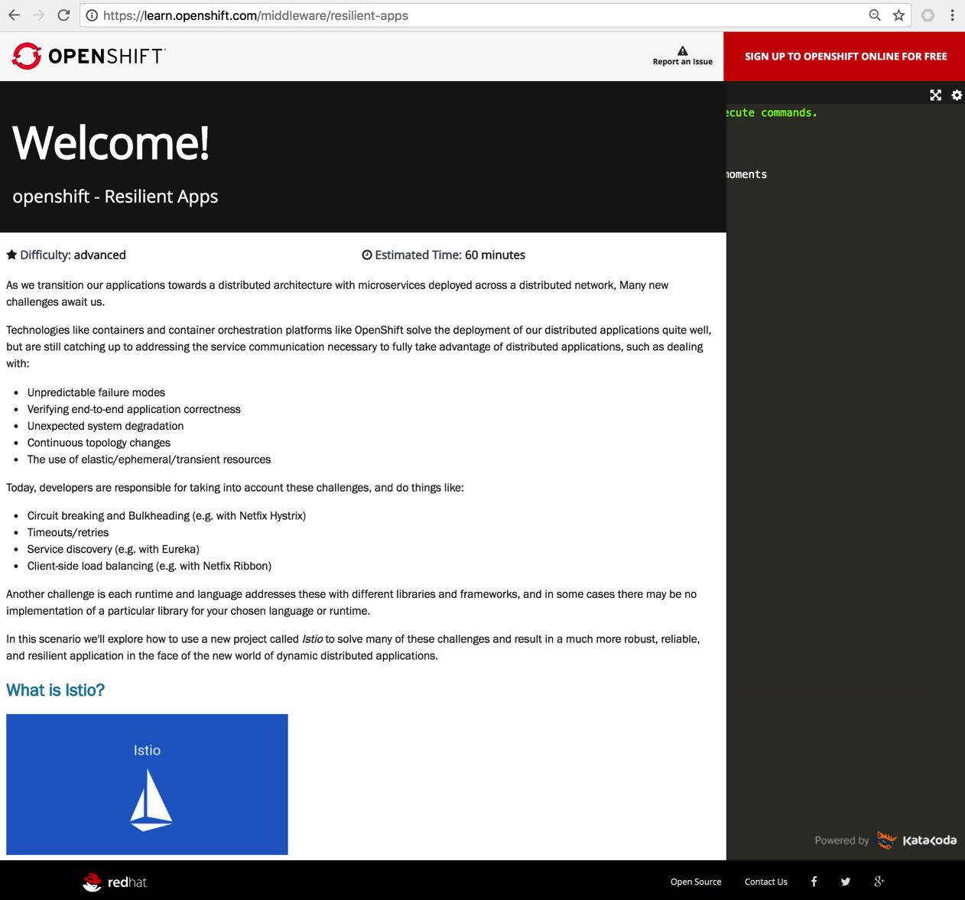
3. Lab 03: Weaving Service Mesh - Istio
https://learn.openshift.com/middleware/resilient-apps

Slide 18

3. Lab 04: Deploying on Service Mesh
Hosting
Edge Proxy
(Load Balancer)
Kubernetes
Node₁
Services
ClusterIP₁
Pod₁
Service Mesh Control Plane
Istio Ingress
Docker₁
ClusterIP₂
Sidecar₁
Istio CA
ClusterIP₃
Istio Pilot
Istio Mixer
Kubernetes
Node₂
Istio Auth
Pod₂
Docker₂

Slide 19
3. Lab 05: Chaining APIs (PoC)
Hosting
Edge Proxy
(Load Balancer)
Kubernetes
Node₁
Service Mesh Control Plane
Services
Pod₁
Pod₂
Docker₁
5
Docker₂
Istio Ingress
ClusterIP₂
(5001)
(5050)
(test1-svc)
(80)
4
(gis-test-sidecar)
(gis-test-api)
Istio CA
1
ClusterIP₁
(6000)
Istio Pilot
2
(test1-ambassador- svc)
3
Pod₃
Istio Mixer
Docker₃
Istio Auth
(gis-validator)

